Slide 1


Slide 2

Automated Data Visualisation for Policymaking.
Session 5
Autumn 2024

Slide 3
Nearly halfway... Re- cap, and what’s coming next
W1. Your Live Site. HTML, CSS, JavaScript. GitHub and embedding.
W2. Data debating – chart design. Raw files, editing data. String and date functions.
W3. The Language of Data. Why visualisation is vital in policy. Manipulating data with Python.
W4. Data. Collection, storage and biases. “Tidy” data storage. Data access. APIs. Scraping with Python.
W5. Programming. Control structures. Loops and conditionals. Combining APIs with loops in Python.
W6. Break. No classes. No homework. Tip: Complete all your portfolio work and start on project.
W7. Maps. Cartography history. Projections. Base maps. Putting data on maps.
W8. Advanced analytics. Transforming data. Investigating relationships.
W9. Big data. Challenges with scale. A big data cookbook.
W10. Machine Learning. History. Regressions and classification. Clustering and dimensionality reduction.
W11. Large Language Models. Gathering, cleaning, visualising data. Auditing output.

Slide 4
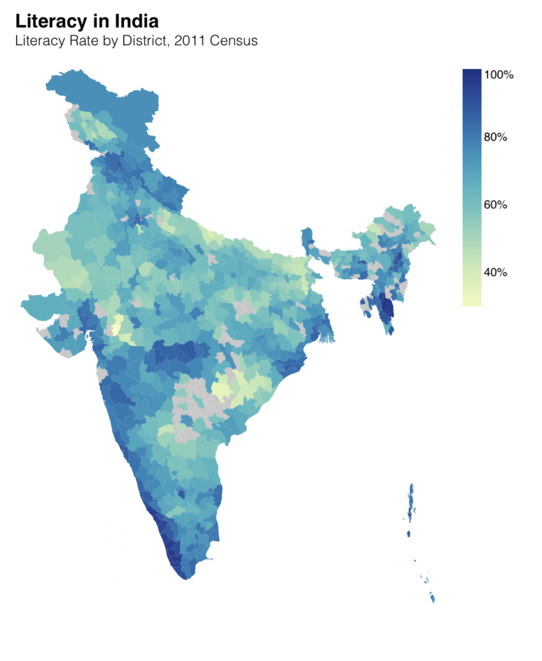
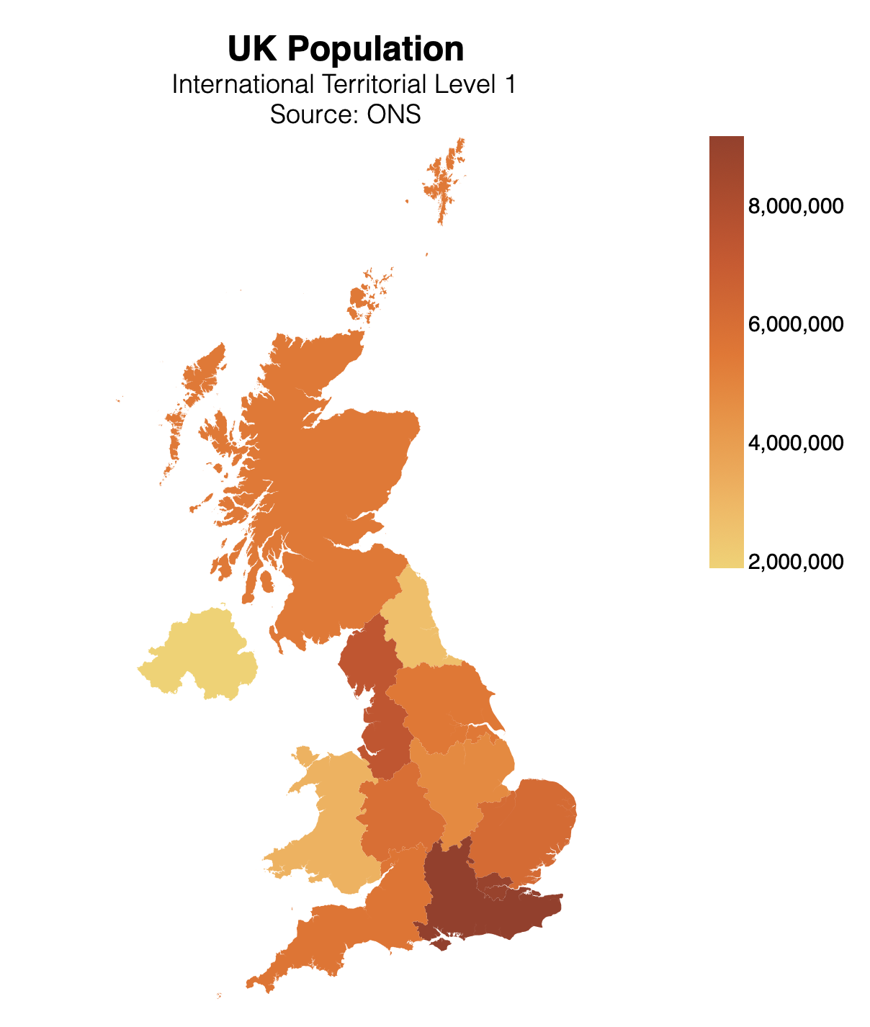
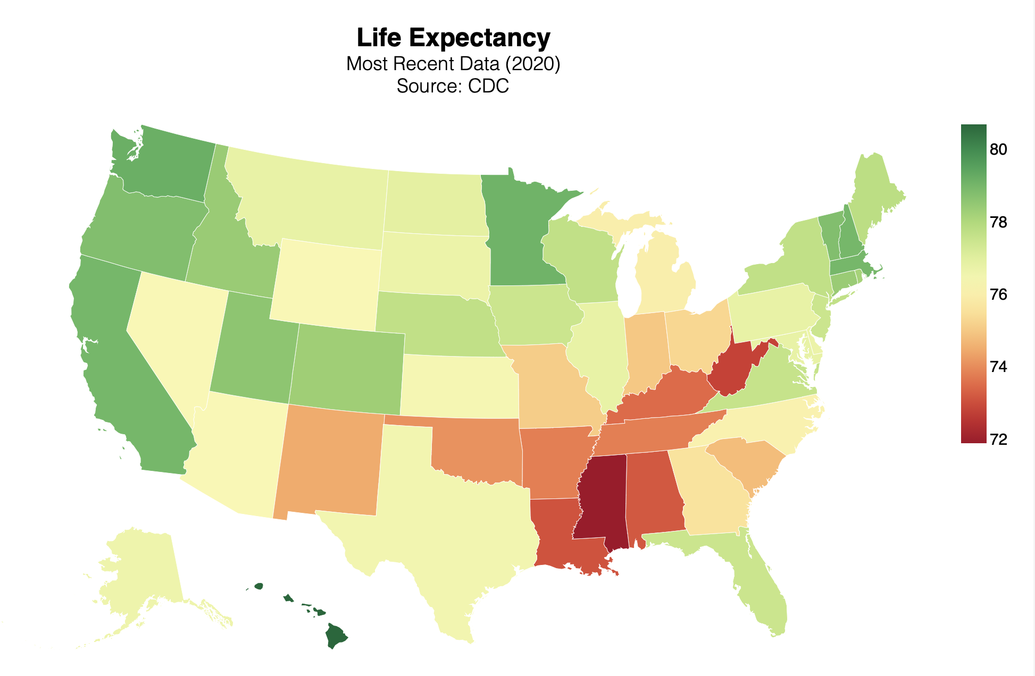
Week 7. After the break
Cartography history. Projections. Base maps. Putting your data on maps.

Slide 5

5. Programming. Making your code do the work for you

Slide 6
Week 5.
Programming. Control structures.
Conditionals. Action/selection based on a criterion.
Loops. Iteration.
Dashboards. Using this to build a dashboard.

Slide 7
5.1 Control Structures. Concepts, languages

Slide 8
The idea.
Control structures | Flow control | Control statements
We want our programs/analysis to take decisions for us. Not to continue doing the same thing again and again, but to be able to decide what to do next.
Without control structures (AKA ‘flow control’) programs don’t do much.
What might you want a program to do for you?
Stop or start.
Take a decision on what to do next. Do different things in different conditions:
Time of day, or days of the week;
If data has certain properties: (stock market alert).
Do something many times.
Dynamic programming / maximisation;
Batches of analysis: downloading, cleaning, charting.

Slide 9
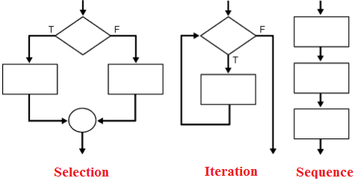
The big three.
Sequence | Iteration | Conditionality/Selection
Programming languages typically feature three types of control:
Sequence. Tells the program the order to do things in.
Selection/conditionality. Makes a decision based on a testable condition.
Iteration. Repeats a command over and over again, until a condition is met. Then stop and continue the code.

Slide 10
Control in data science.
If-else | Loops
In practical terms during a career in data you are going to make daily use two particular examples of these general ideas.
If-else. Test some condition in your data. Based on the results of this test, take a number of different actions.
Loops. Do the same thing to many pieces of data, many variables, many data sets. Or do the same thing on a number of different days.
These can be combined all possible ways.
An if statement inside an if (AKA “nested”)
A loop withing a loop.
If inside a loop
Loop inside an if.

Slide 11
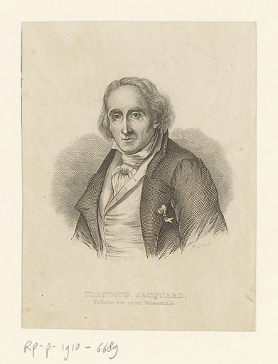
History: Joseph Marie Jacquard.
The origins of programming
Jacquard (1752-1834) was a French merchant, weaver, and inventor.
From his base in Lyon – which he defended on the side of the revolutionaries during the French revolution – he developed the Jacquard machine.
It was the first programmable loom.
Though unpopular with textile workers, whose labour it automated, the loom would spread across France, and eventually the industrialising world.
Jacquard

Slide 12
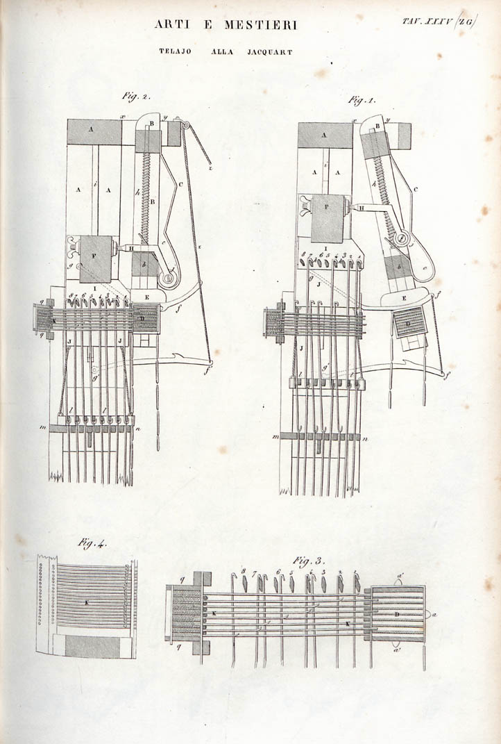
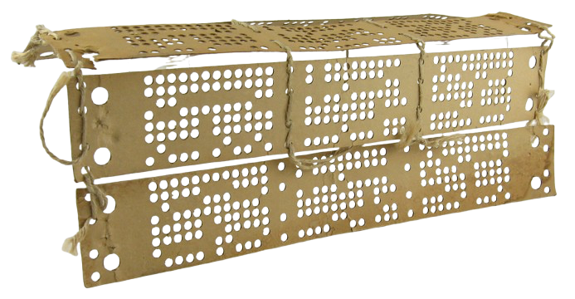
History: Jaquard’s Machine.
The origins of programming
Invented by Jacquard in 1804, the loom revolutionised textile production. It used punch cards to automate complex patterns.
(Museum of Obsolete Media)
This was a revolutionary change – it could be reprogrammed just by punching holes into a card.
It was not a computer itself but the innovation of the loom’s binary system laid the groundwork for programmable computers.

Slide 13
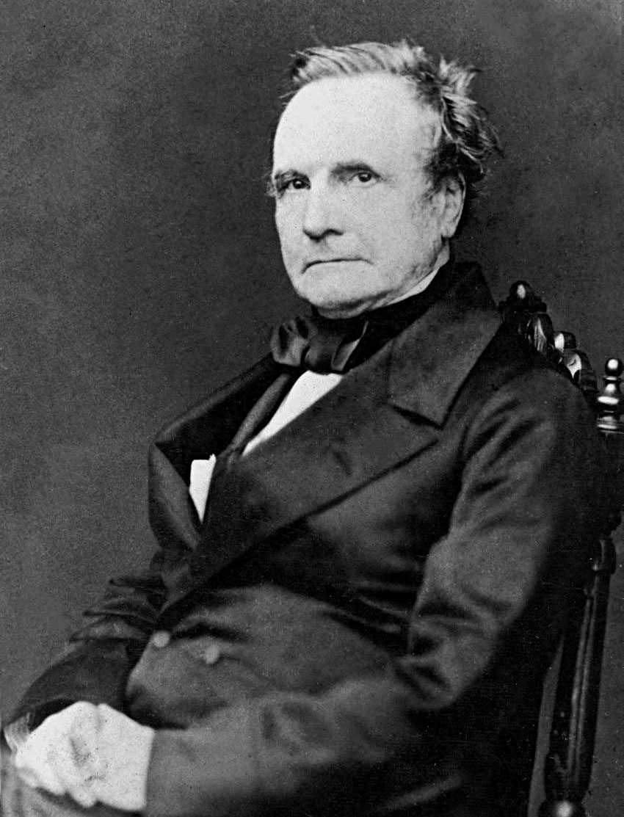
History: Charles Babbage.
The father of computing
Jacquard’s programmable loom would inspire an Englishman, Charles Babbage (1791-1871).
Babbage was a polymath - mathematician, philosopher, engineer – who designed the first computer.
Punch card programming
Jacquard
Programmable Loom
Babbage
First computer design
“the Analytical Engine weaves algebraical patterns just as the Jacquard loom weaves flowers and leaves”
Ada Lovelace

Slide 14
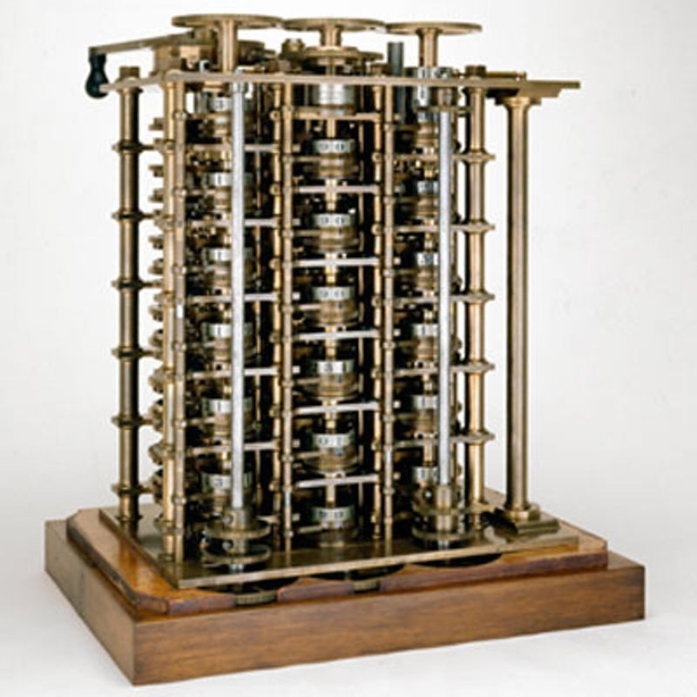
History: Charles Babbage.
His machines
Charles Babbage, the “father of computing,” designed the Difference Engine and Analytical Engine to automate calculations.
Difference Engine. A mechanical calculator that automates calculations with finite differences, using repeated addition in place of multiplication or division.
Analytical Engine. A general-purpose computing machine concept. It featured punched cards for programming, memory (store) and processing (Mill) units. It would execute conditional operations.
The analytical engine introduced the tools we use today: loops and conditionals, among others. If it were constructed in Babbage’s lifetime, it would have been the first computer.

Slide 15
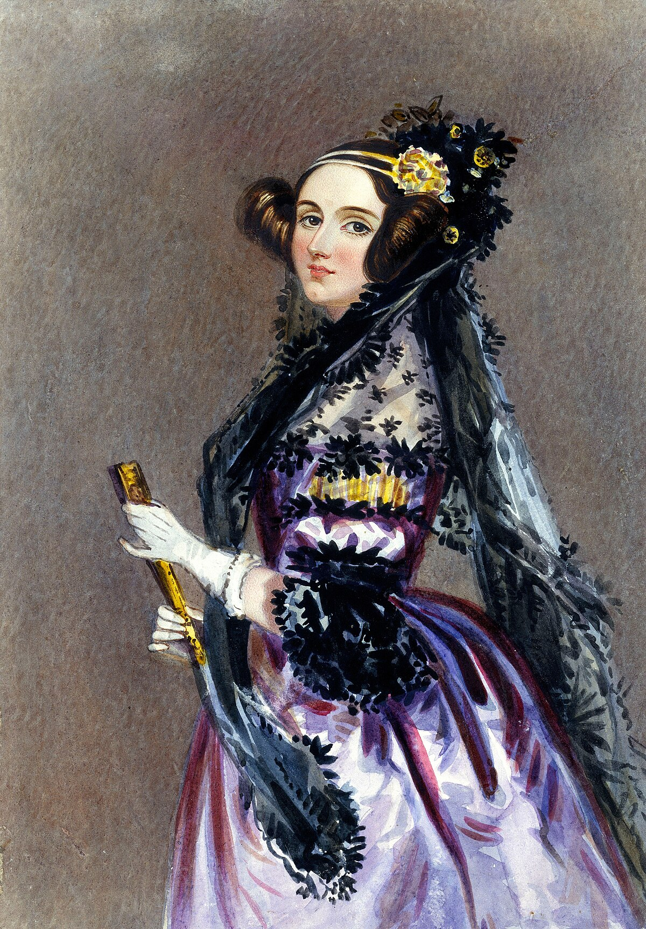
History: Ada Lovelace.
English mathematician and writer
Aged sixteen Ada met Charles Babbage and corresponded about Babbage’s Difference Engine and The Analytical Engine.
Translated an article by an Italian engineer (Luigi Menabrea) on Babbage’s Analytical Engine to English. The translation took 9 months. An appendix with commentary was three times as long as the translation. The translated notes and commentary were published in 1943.
Ada recognised the ability of Babbage’s Analytical Engine to carry out complex sequences of mathematical operation. The notes include an example of how to calculate Bernoulli numbers – this is regarded as the first computer program.
International Ada Lovelace Day: second Tuesday of October. Celebrates the contributions of women in STEM.
Augusta Ada King, Countess of Lovelace. 1815-1852
Taylor, R. (Ed.). (1843). Scientific Memoirs, Selected from the Transactions of Foreign Academies of Science and Learned Societies, and from Foreign Journals (Vol. 3, pp. 660–702). R. and J. E. Taylor.
Notes:
Sources:
- https://www.britannica.com/story/ada-lovelace-the-first-computer-programmer
https://engineering.blogs.bristol.ac.uk/ada-lovelace-building-new-home-engineering-maths

Slide 16
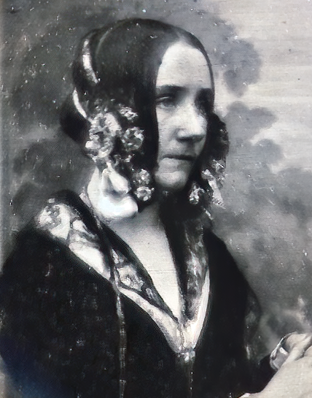
History: Ada Lovelace.
The first programmer
In correspondence with Babbage, Ada Lovelace (1815-1852) would program the first algorithm for the analytical machine, an algorithm to compute Bernoulli numbers.
Punch card programming
Bernoulli sequence
Jacquard
Programmable Loom
Babbage
First computer design
Lovelace
The first programmer

Slide 17
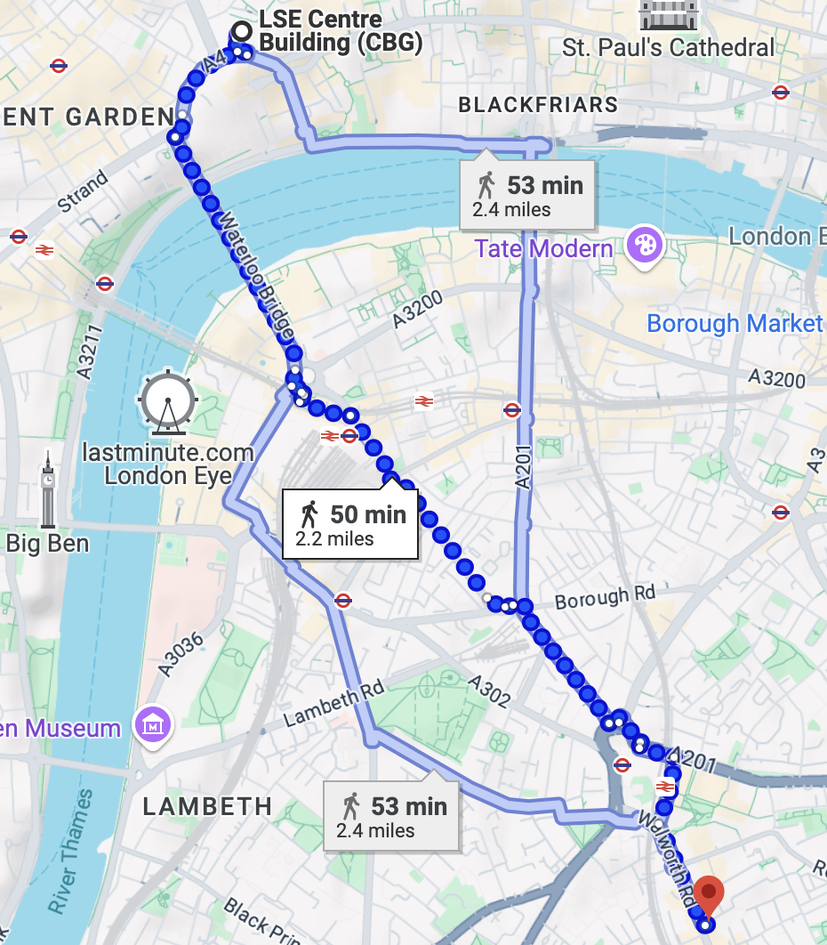
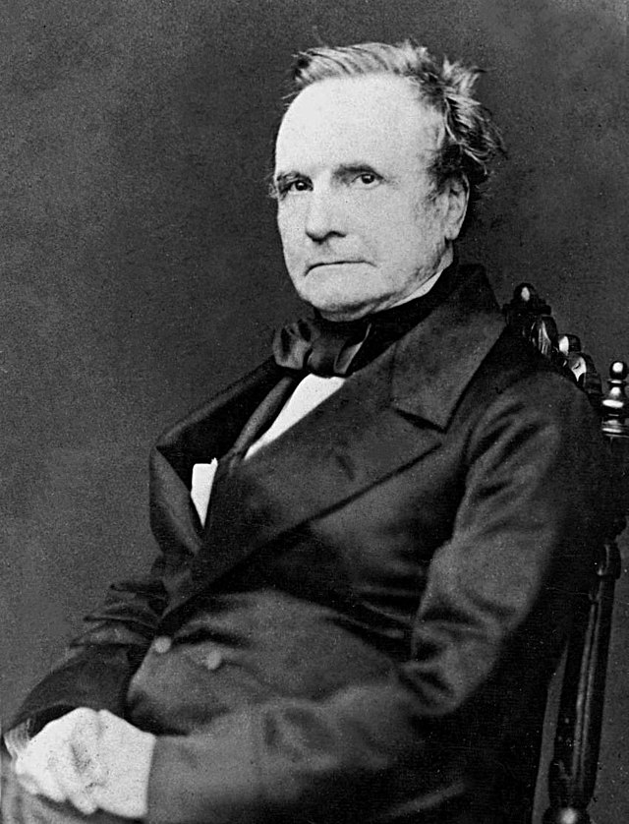
London tour IV. Charles Babbage.
Plaque on Larcom Street. 50 min walk.
Notes:
Charles Babbage blue plaque.
Science Museum built Babbage’s Difference Engine 2 in 2002.

Slide 18
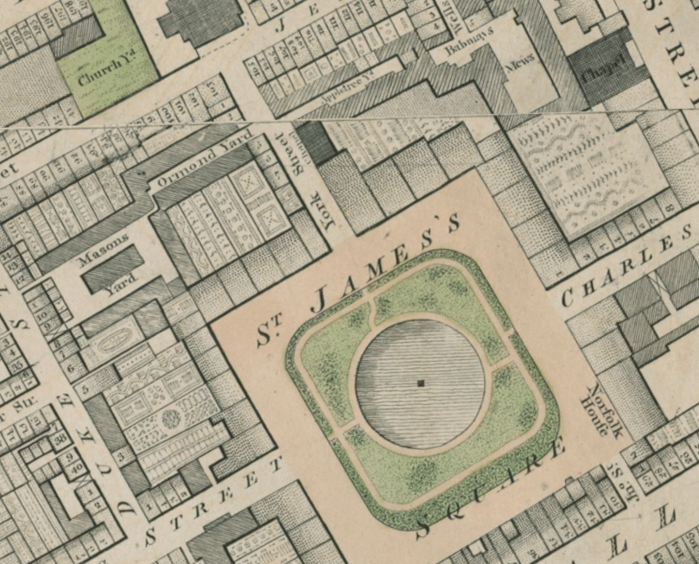
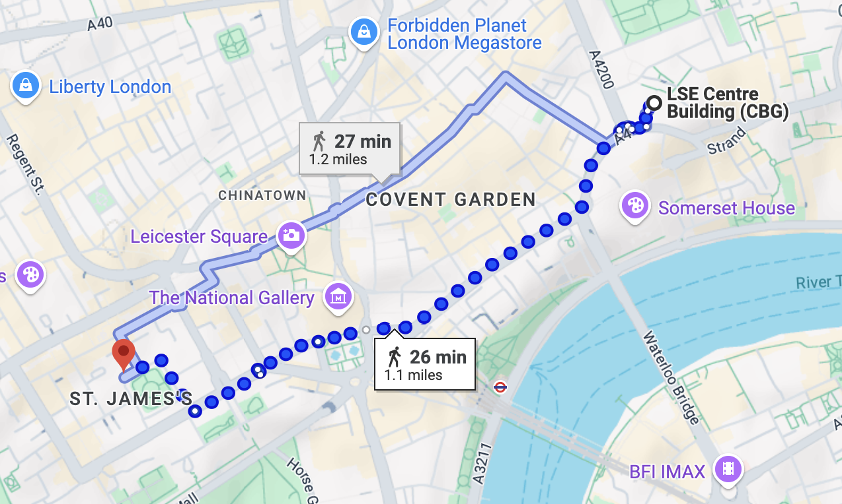
London tour V. Ada Lovelace
Blue plaque St James Sq. 26m walk.
Notes:
Ada Lovelace blue plaque

Slide 19
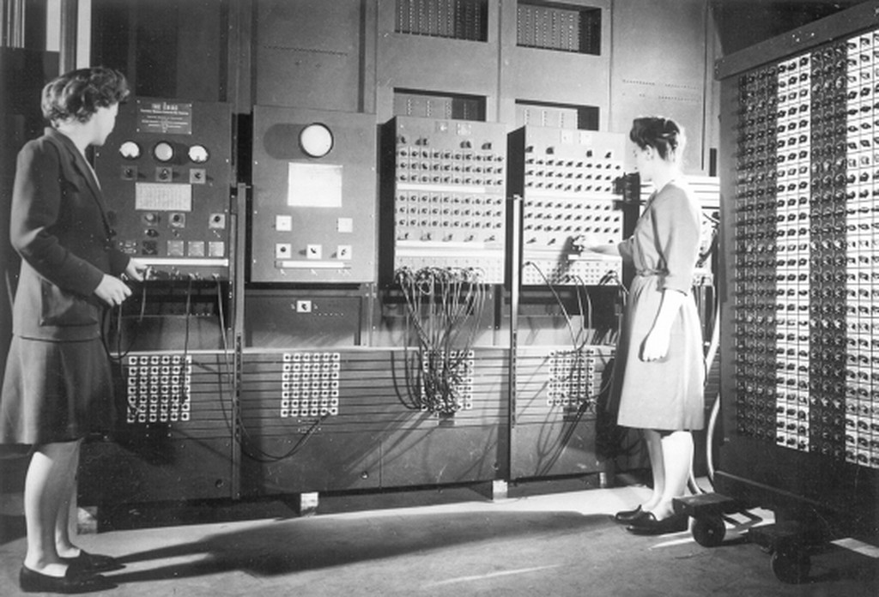
History: ENIAC.
The first computer – conditionals and loops
The Electronic Numerical Integrator and Computer was the first general purpose computer.
Completed in 1945, at University of Pennsylvania's Moore School of Engineering.
It was programmable, electronic and Turing complete.
https://penntoday.upenn.edu/news/worlds-first-general-purpose-computer-turns-75
Notes:
Add:
- Who invented the ENIAC? What year was this? Etc

Slide 20
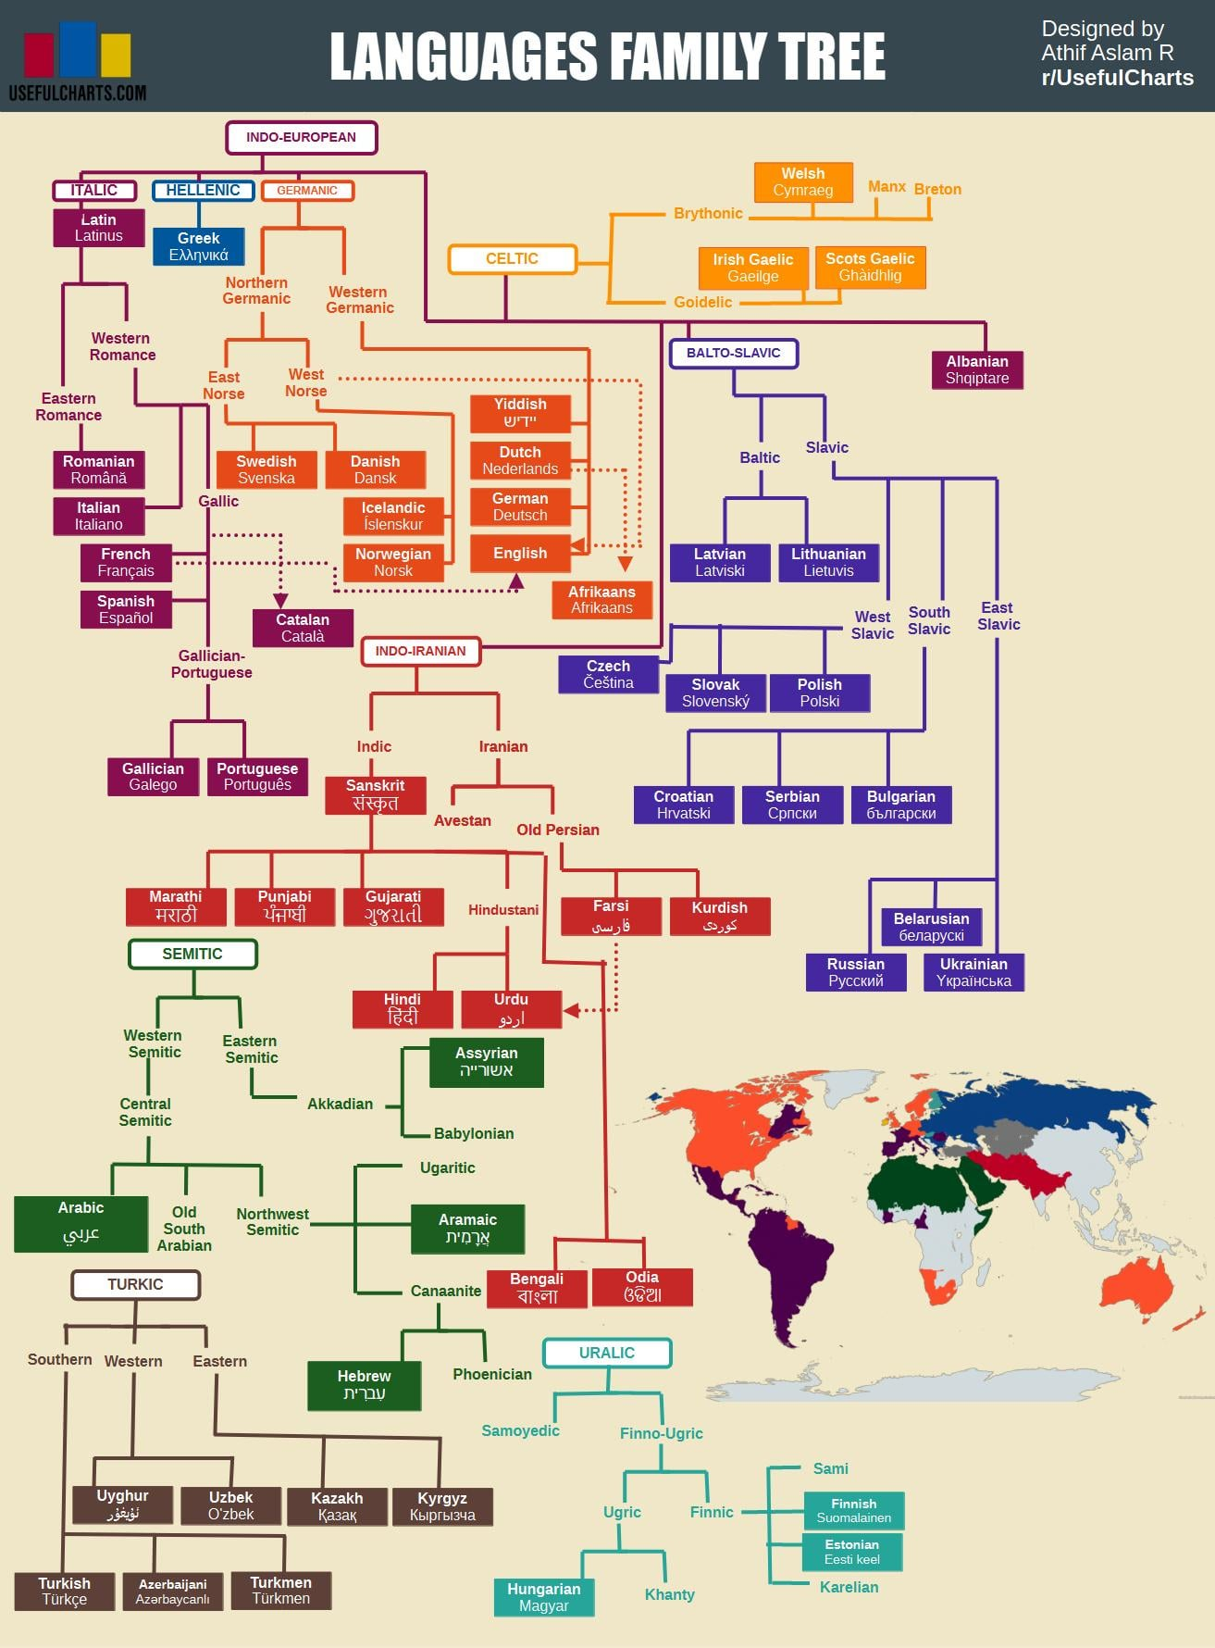
How many languages?
How many in the room?
Approximately 7,000 spoken languages globally.
Languages are grouped into families based on common ancestral roots.
The largest family is Indo-European, covering languages spoken by over 3 billion people, e.g. English, Spanish, Hindi etc.
Languages evolve. Latin developed into entirely new languages (e.g., Italian, French, Spanish).
Around 40% of languages are considered endangered. Most are spoken by fewer than 10,000 people.
Austin, P. K., & Sallabank, J. (Eds.). (2011). The Cambridge Handbook of Endangered Languages. Cambridge: Cambridge University Press.
Notes:
References:
The Cambridge Handbook of Endangered Languages, 2011
Austin, P. K., & Sallabank, J. (Eds.). (2011). The Cambridge Handbook of Endangered Languages. Cambridge: Cambridge University Press.
Extra info:
- https://www.ethnologue.com/insights/ethnologue200/
- "The Power of Babel: A Natural History of Language" by John H. McWhorter

Slide 21

https://www.theguardian.com/education/gallery/2015/jan/23/a-language-family-tree-in-pictures

Slide 22





How many languages?
Five?

Slide 23
How many languages?
Three?

Slide 24



How many languages?
Most high-level languages have loops that you will be able to understand.

Slide 25

From code to metal.
Many languages, one result
Why are languages so similar?
Every language has the same purpose – to turn abstract instructions into 0s and 1s.
They just take different routes.
JavaScript
Machine code
Basic set of instructions e.g. “10110000 00000001”
Interpreted by your browser to create bytecode, which is then translated into machine code.
Python
Compiled into efficient ‘bytecode’ then interpreted when run .
C
The CPU
Compiled directly into machine code.

Slide 26
5.2 Conditionals. A fork in the road

Slide 27

Code as a tree | Conditional statements influence which branch your code goes along.

Slide 28
If-else.
Excel | STATA | Python | JavaScript | CSS
Syntax:
IF({CONDITION}, {VALUE IF TRUE}, {VALUE IF FALSE})
Example:
=if(A1=“Richard”, “Yes”, “No”)

Slide 29
If-else.
Excel | STATA | Python | JavaScript | CSS
Practical usage:
Data cleaning
You have two data sets on countries that you want to match.
But the names are not consistent.
You want to create a column that provides a 1:1 correspondence between the data sets
=if(A1=“Côte d'Ivoire”, “Ivory Coast”, A1)
Categorisation
You have data on firm size, measured by number of employees…
You want to analyse based on two types, large firms and SMEs..
You define SME as anything with up to 250 employees..
=if(A1>250, “Large”, “SME”)

Slide 30
If-else – what does equal mean?
Excel | STATA | Python | JavaScript | CSS
?
= == ===

Slide 31
=, == and ===
Three uses of equals signs: Stata | JS | Python
= Assigns value | i.e. it makes the thing on the left equal the thing on the right.
== Tests value | It checks whether the thing on the left is equal to the thing on the right.
=== Tests value and type | Is the thing on the left the same value and the same type (number, word, etc) as the thing on the right (only in JavaScript).
Notes:
NOTE: === does not exist within Python. Only in JavaScript and some other languages.

Slide 32
If-else – what does equal mean?
Excel | STATA | Python | JavaScript | CSS
Joe = President
Joe == President
Joe === President

Slide 33
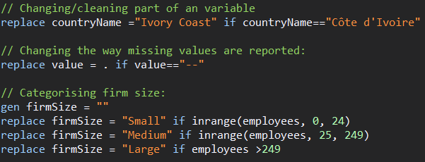
If-else.
Excel | STATA | Python | JavaScript | CSS

Slide 34
If-else.
Excel | STATA | Python | JavaScript | CSS
# Simple if:
if CONDITION:
#Code to run if true
#Can be more than one line
# If else:
if CONDITION:
# Code to run if true
else
# Code to run if condition is FALSE
# Elif
if CONDITION_A:
# Code to run if conditionA TRUE.
elif CONDITION_B:
# Code to run if conditionB TRUE.
else:
# Code to run if BOTH conditions are FALSE.

Slide 35
If-else.
Excel | STATA | Python | JavaScript | CSS
# Example: how big are firms in our dataset?
firm1 = 14
firm2 = 250
# Comparing values
if firm1 > firm2:
print("Firm 1 has more employees than Firm 2")
else:
print("Firm 2 has more employees than Firm 1")
# Assessing size
if firm1 > 249:
print("Firm 1 is large")
else:
print("Firm 1 is an SME")

Slide 36
If-else.
Excel | STATA | Python | JavaScript | CSS
//Simple if condition
if (condition) {
// Add code here--can be many lines, to run if the condition is TRUE.
// If the condition is FALSE then nothing happens
}
//If else
if (condition) {
// Code to run if condition TRUE.
} else {
// Code to run if condition FALSE.
}
//If-elif-else:
if (conditionA) {
// Code to run if conditionA TRUE.
} else if (conditionB) {
// Code to run if conditionB TRUE.
} else {
// Code to run if BOTH conditionA and conditionB are FALSE.
}

Slide 37
If-else.
Excel | STATA | Python | JavaScript | CSS
CSS does not officially support conditionals.
But there is a way we can make CSS react in different ways in different situations?
Media Queries (@media) allow you to change the look based on screen size:
With these you are saying:
If the screen size is {CONDITION} then do this {ACTION}
So CSS does allow conditionals.
Understanding this is the way to make your site have two looks: one for mobile, one for laptop/desktop.

Slide 38
”expr": "datum.country == ‘gbr’ ? ‘red’ : ’blue’"
Ternary operators.
Excel | STATA | Python | JavaScript | CSS
“transform”: [{
“calculate”: "datum.value >= 0 ? ‘positive’ : ’negative’",
“as”: ”sign”
}]
Ternary operators are shorthand for simple if-else statements.
Allows us to create concise expressions that evaluate to one of two values.
condition ? expression_if_true : expression_if_false
(Vega-Lite) “datum.age >= 18 ? ‘adult’ : ‘child’”
(JavaScript) let result = age >= 18 ? 'Adult' : 'Child’;
(Python) result = 'Adult' if age >= 18 else 'Child’
(R) result <- ifelse(age >= 18, 'Adult', 'Child')

Slide 39
Examples. Why are conditionals so useful?

Slide 40
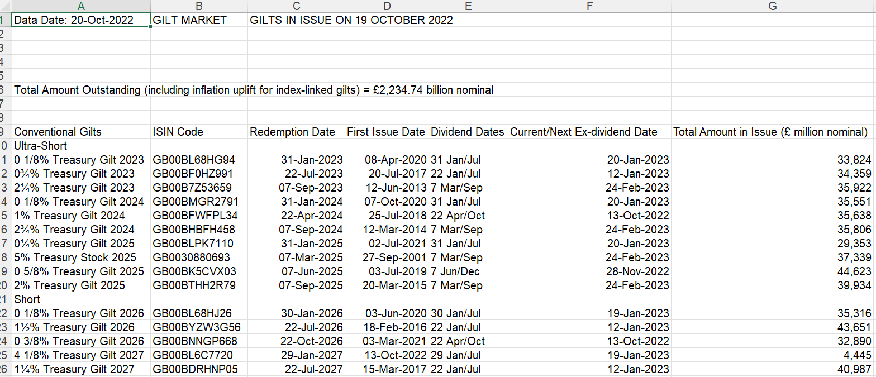
Example 1. Cleaning. UK Gilt Market
Excel | STATA | Python | JavaScript | CSS
https://dmo.gov.uk/data/gilt-market/gilts-in-issue/

Slide 41
Example 1. UK Gilt Market
How would you clean this data?
0 1/8% Treasury Gilt 2023
0¾% Treasury Gilt 2023
2¼% Treasury Gilt 2023
5% Treasury Stock 2025
1 5/8% Treasury Gilt 2028
6% Treasury Stock 2028
0¼% Treasury Gilt 2031
1% Treasury Gilt 2032
4¼% Treasury Stock 2032
0 7/8% Green Gilt 2033
4½% Treasury Gilt 2034
1 1/8% Treasury Gilt 2073
0 1/8% Index-linked Treasury Gilt 2046
0¾% Index-linked Treasury Gilt 2047
0 1/8% Index-linked Treasury Gilt 2048
0½% Index-linked Treasury Gilt 2050
4 1/8% Index-linked Treasury Stock 2030
2% Index-linked Treasury Stock 2035
Cleaning data is often a matter of:
1. Spotting patterns in the data. Where in the mess of string does the number that you want appear?
2. Using string functions to split, separate and change the data in other ways.
You will very often us programming logic – if statements – to do this.

Slide 42
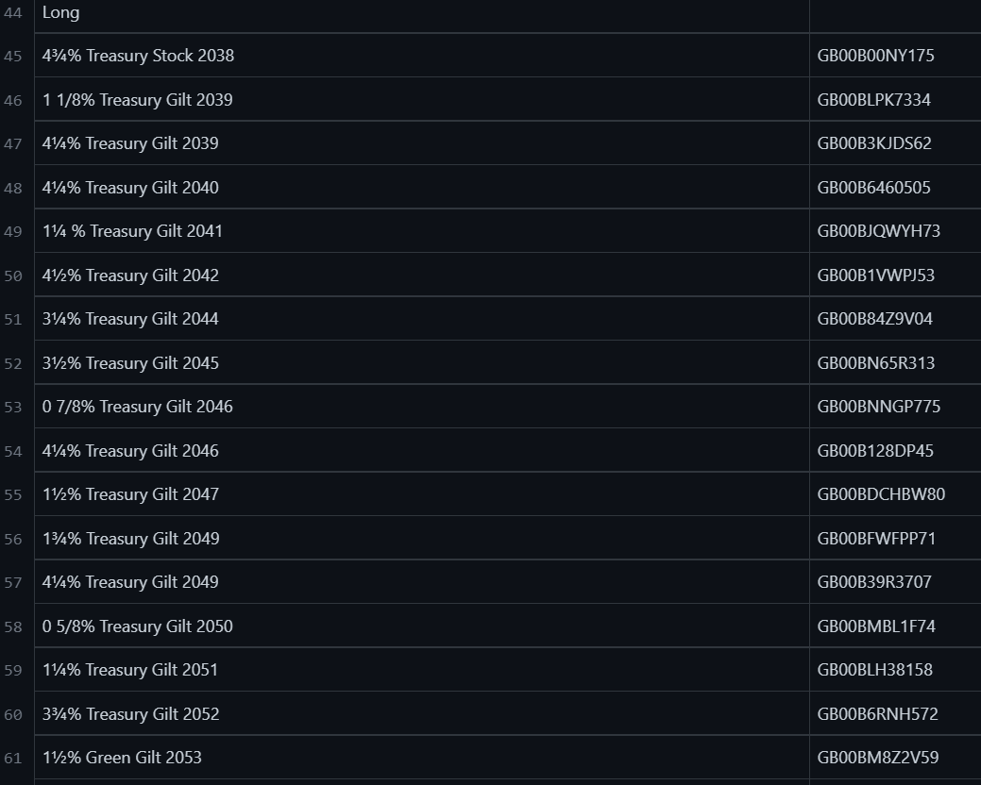
Example 1. UK Gilt Market
Excel | STATA | Python | JavaScript | CSS
https://github.com/RDeconomist/RDeconomist.github.io/blob/main/data/GiltsInIssueRaw.csv

Slide 43
Example 1. UK Gilt Market
Excel | STATA | Python | JavaScript | CSS
[...]
///////////////////////////////////////////////////////////////////
//2. USING STRING FUNCTIONS TO CLEAN THE DATA:
// Destring:
destring issueAmount baseRPI amountINCinfUplift, ignore("," ) replace
// Problem variable: looks like this:
// "0 5/8% Treasury Gilt 2025"
// We want to ge the type, and the coupon.
/// String split, based on a character:
split type, parse("T") generate(type2)
order type*
/// String concatenate:
** This adds back the missing "T".
gen T = "T"
replace type22 = T+type22
drop T
/// Genearting a substring, based on the kown position of a chatacter:
replace type22 = substr(type22, 1, strpos(type22, "2") - 1)
/// Trimming the leading and trailing spaces from around a variable:
replace type22 = strrtrim(type22)
[...]
With a combination of string functions, we can clean the raw data with Stata:
Upper, lower
Split:
At a fixed position.
At a character.
Concatenate
Measuring:
Find the Length
Find the position of a character
Substring
Trim
github.com/RDeconomist/RDeconomist.github.io/blob/main/data/giltsCleaningData.do

Slide 44
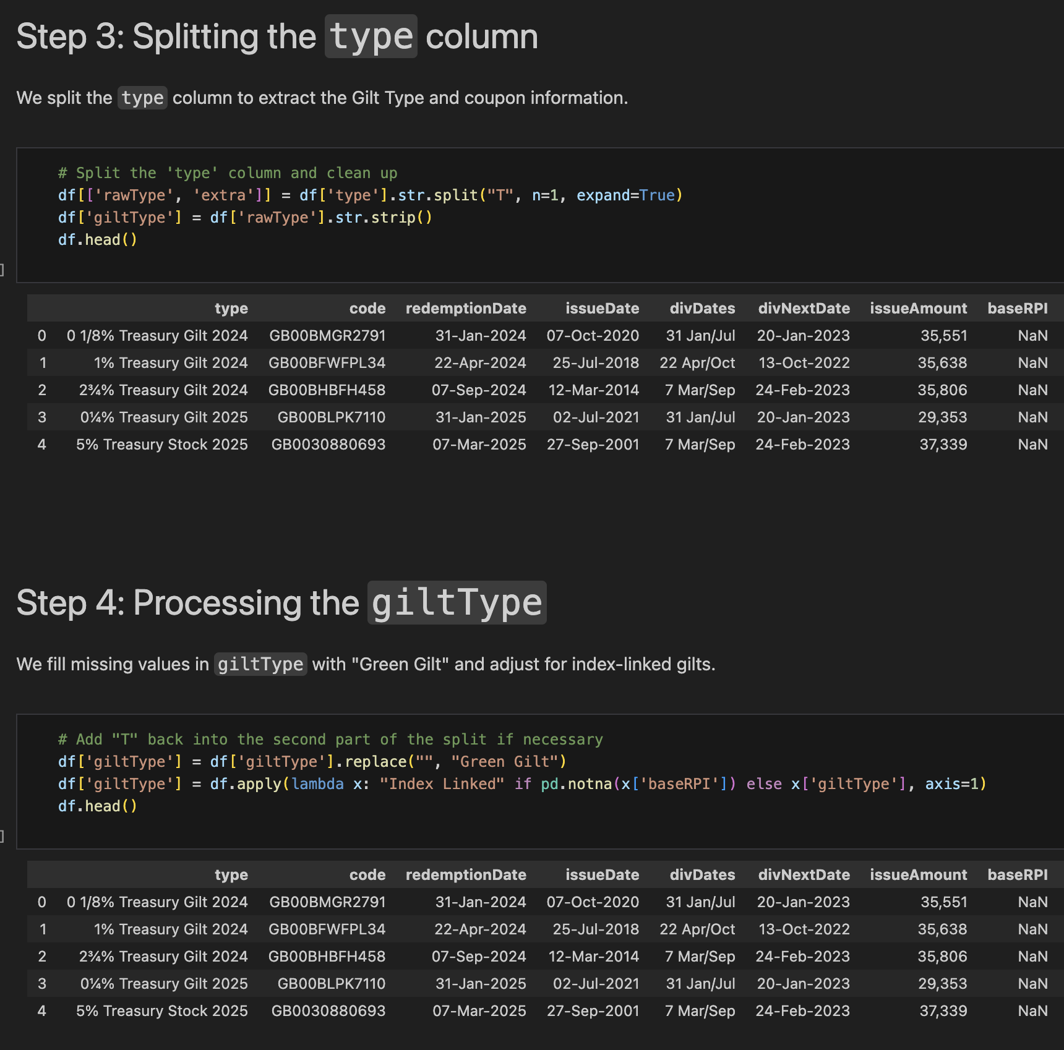
Example 1. UK Gilt Market
Excel | STATA | Python | JavaScript | CSS
And do the same thing with Python, using built-in Pandas methods:
Upper, lower: str.upper, str.lower
Split: str.split()
Length: str.len()
Substring: str[x:y]
Trim: str.strip()
github.com/jhellingsdata/RADataHub/blob/main/misc/cleaning_dmo_data.ipynb

Slide 45
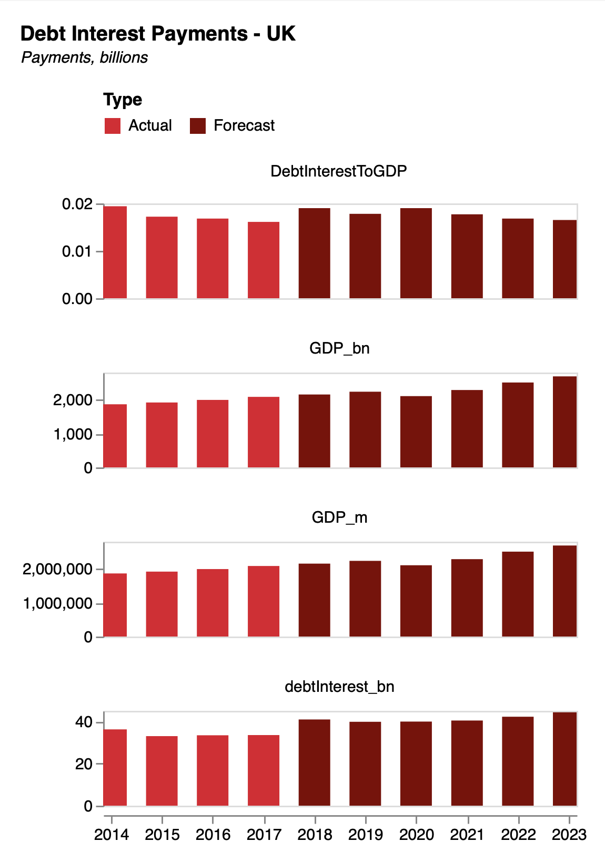
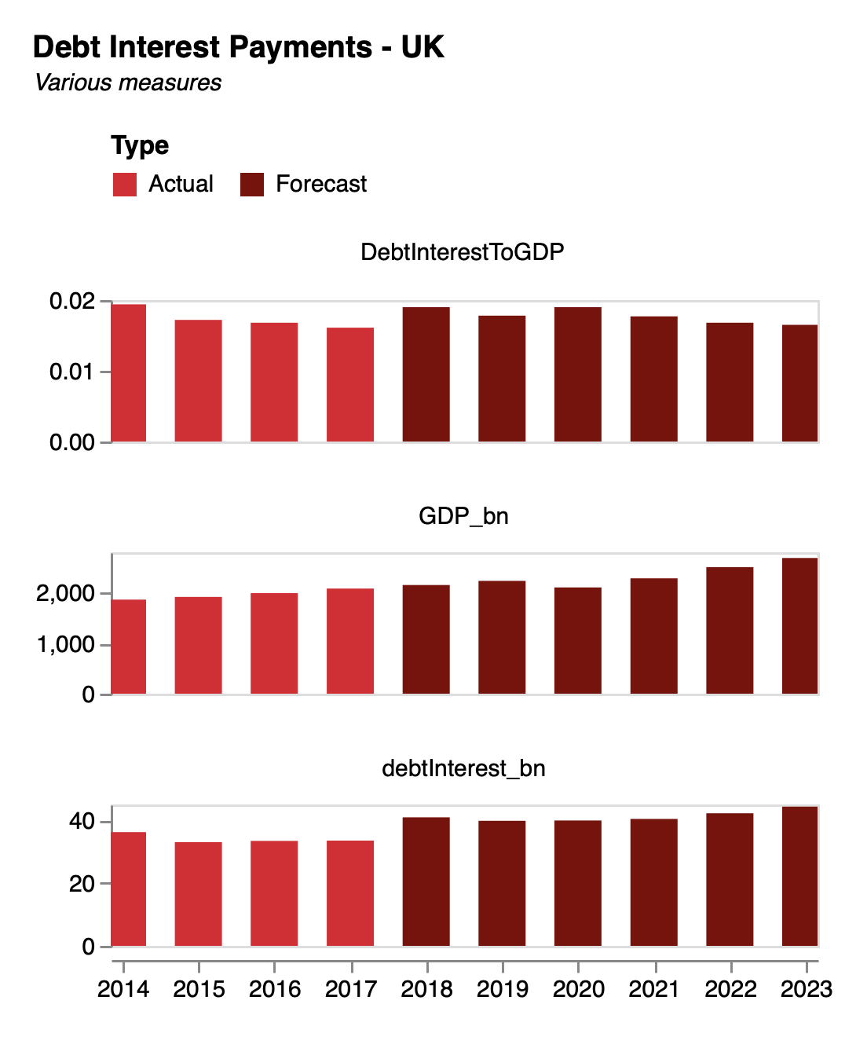
Example 2. In Vega-Lite.
Using conditionals in your charts
With a Vega-lite filter transform, we can restrict the data to just the variables or values we care about.
Recall our debt example from earlier in the course.
For code see: richarddavies.io/library
"transform": [
{"filter":{
"field": "Variable",
"oneOf":["DebtInterestToGDP", "GDP_bn", "debtInterest_bn"]
}}
],

Slide 46
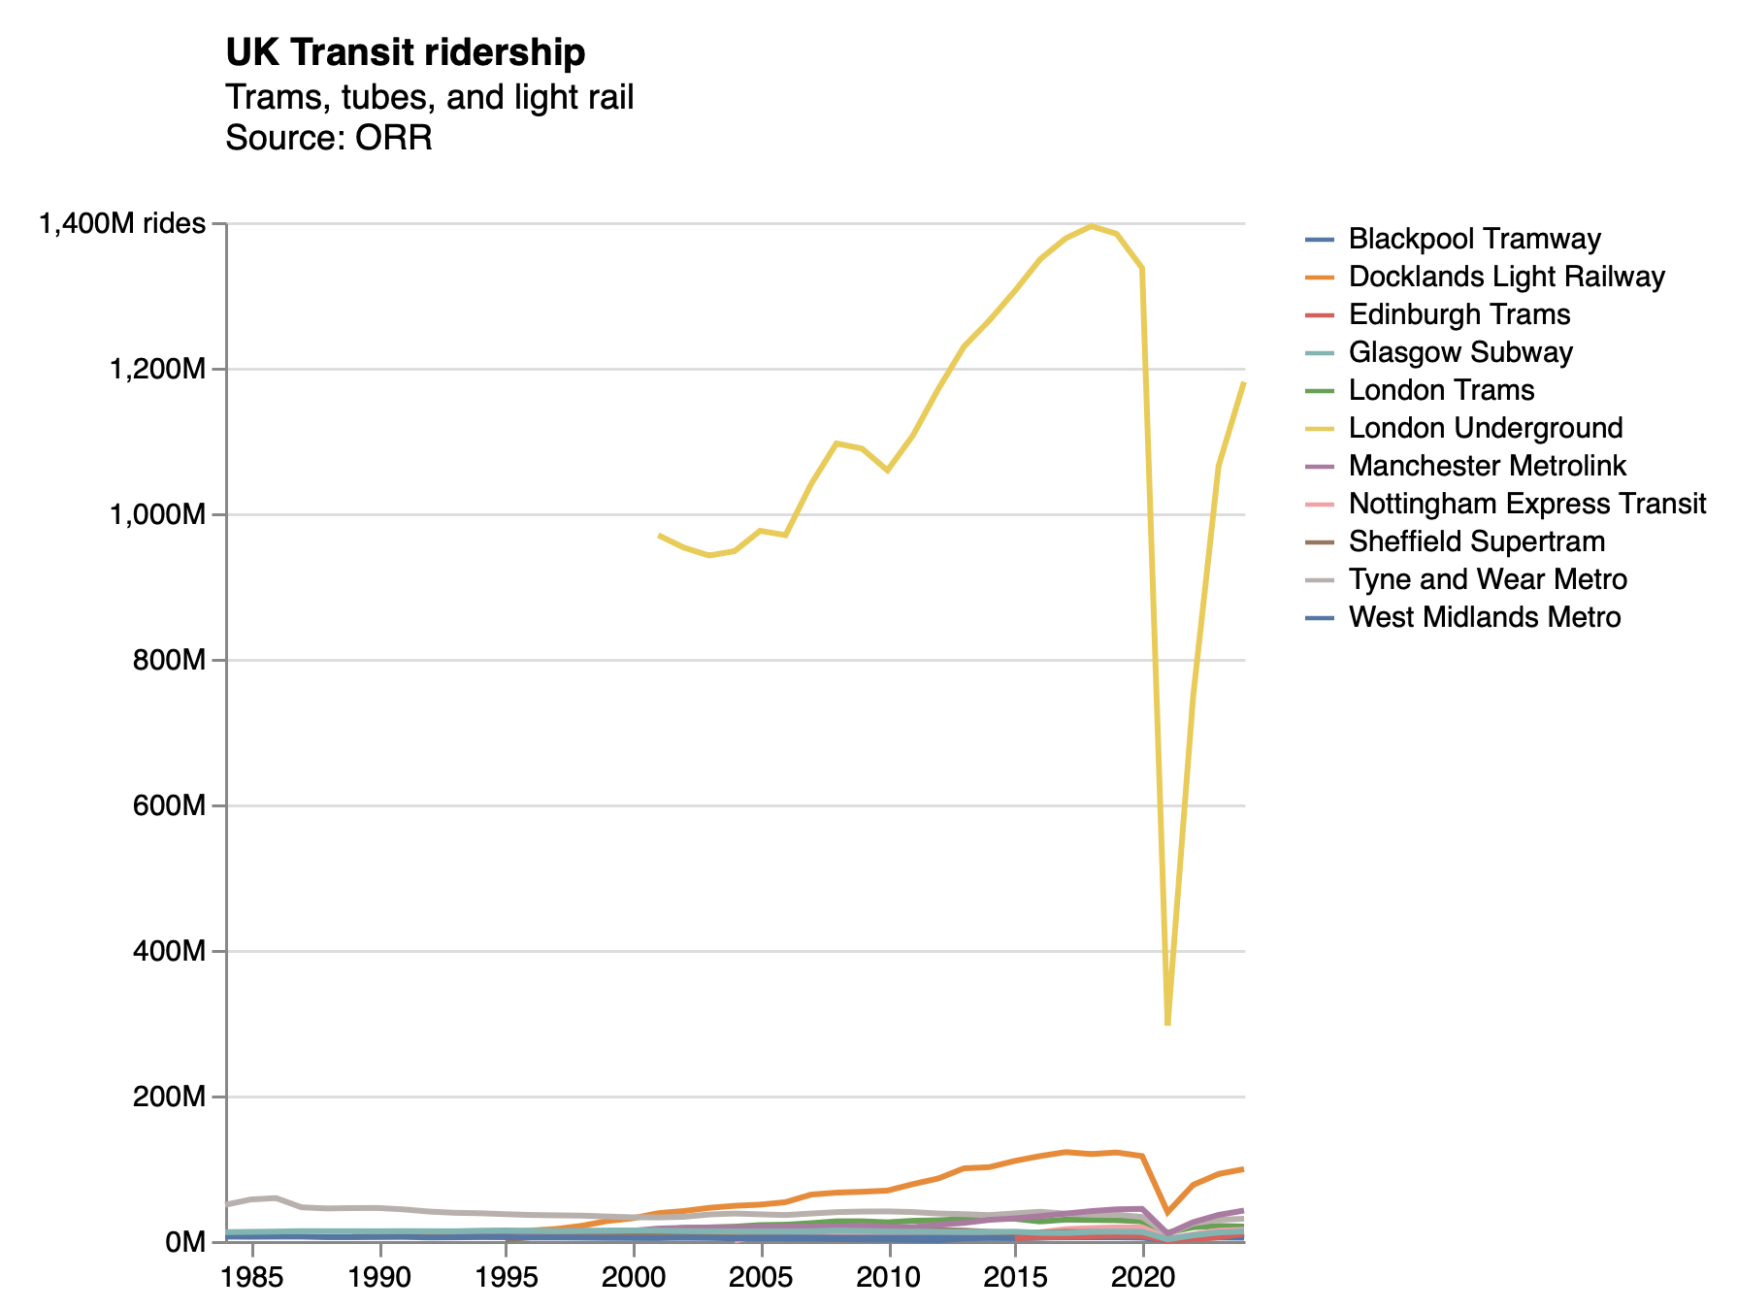
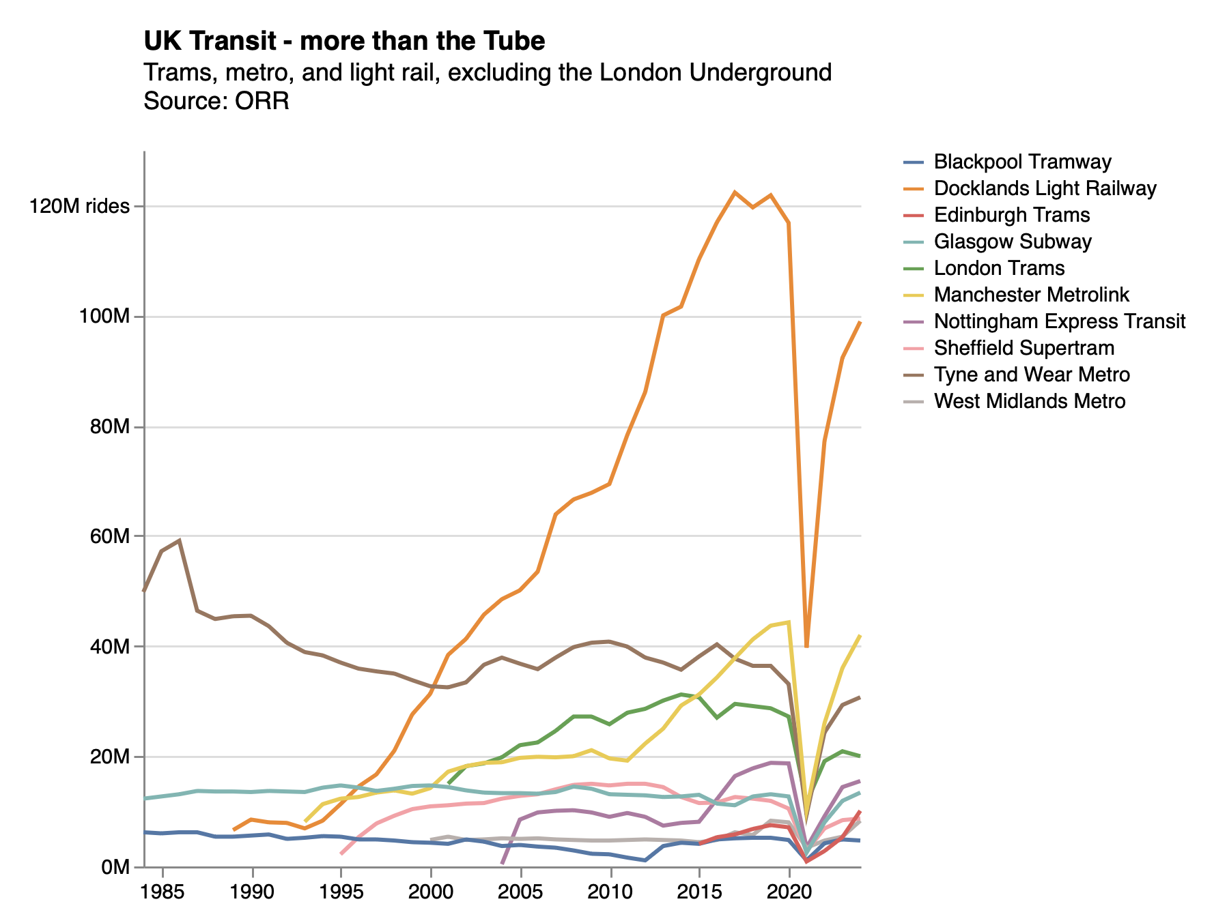
Example 3. Vega-Lite.
Using conditionals to filter extreme values
"transform": [
{
"filter":"datum.value < 250"
}
],
We can filter out the most extreme values to see what’s happening in the rest of the data:

Slide 47
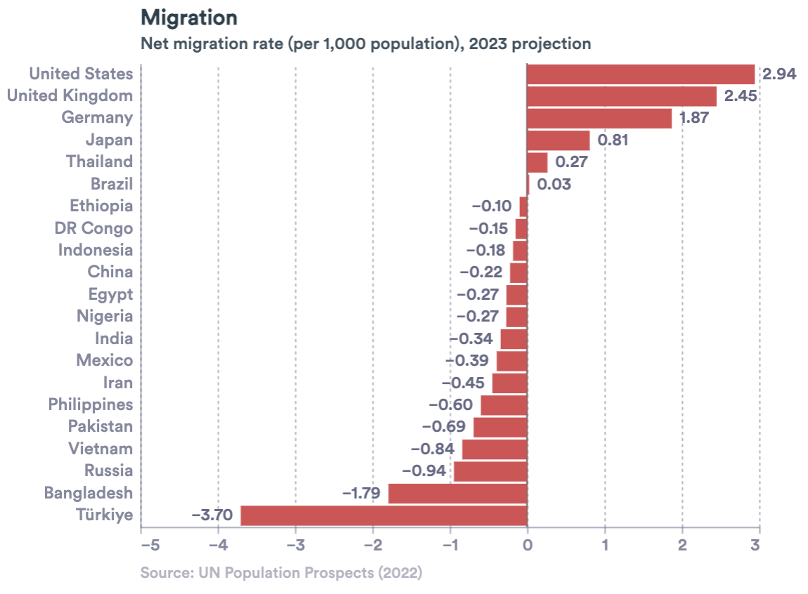
Example 4. Vega-Lite.
Using conditionals with ternary operators
”mark”: {
”type”: ”text”,
”align”: {
”expr”: "datum['Net Migration Rate'] < 0 ? 'right' : 'left’”
},
”dx”: {
”expr”: "datum[‘Net Migration Rate’] < 0 ? -5 : 5"
}
},
Ternary operators allow us to use normal if-else statements within Vega-Lite.
condition ? expression_if_true : expression_if_false
This is useful in transforms, label expressions and expressions for customising properties.
Here, we use an expression to test the sign of each ‘Net Migration Rate’ value. If positive, we position the text label to the right of the bar. If negative, position to left of the bar.
Notes:
NOTE: may add own slide on ‘ternary operators’. Examples within

Slide 48
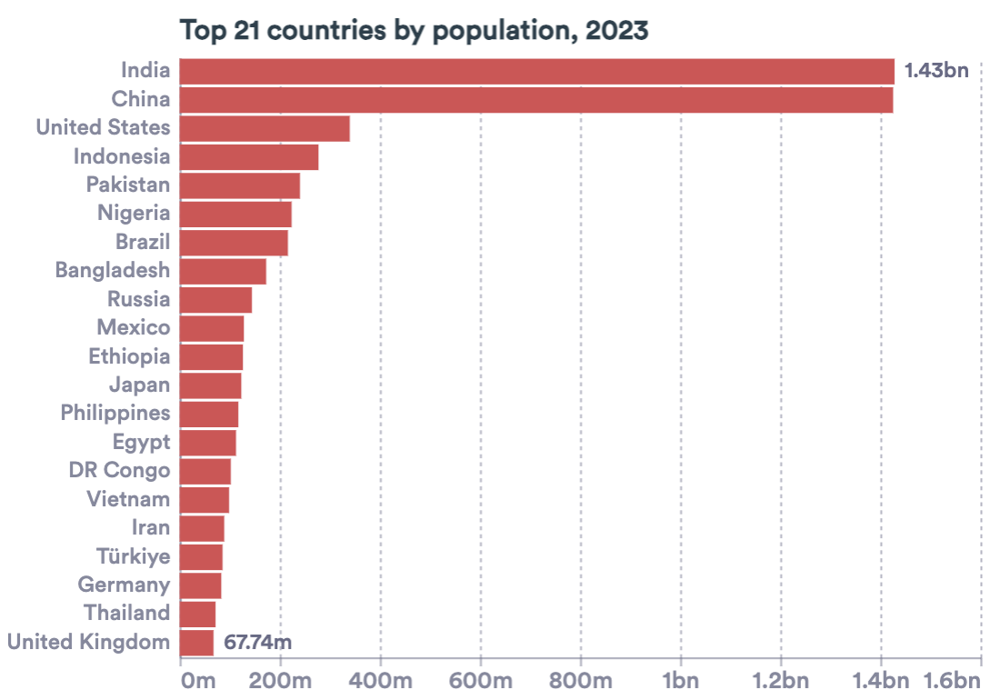
Example 5. Vega-Lite.
Using conditionals with ternary operators
Ternary operators allow us to use normal if-else statements within Vega-Lite.
In a label expression, the axis label text and values can be accessed through `datum.value` and `datum.label`.
Here, we test whether the label value is below 1 billion (1e9), if yes: we denote as millions with ‘m’, if no: we denote as billions with ‘bn’.
"field": "Population",
"type": "quantitative”,
"axis": {
“labelExpr": "datum.value < 1e9 ? datum.value/1e6 + 'm' : datum.value/1e9 + 'bn’”
},
Notes:
We can use label expressions (“labelExpr”) to add custom formatting.
In a label expression, we can access the values / labels of the axis labels using `datum.value` or `datum.label`. Then, we can use any expression we like to adjust these label values.
For instance, “labelExpr”: “’£’ + datum.value” will prepend a pound sign to the label value.

Slide 49
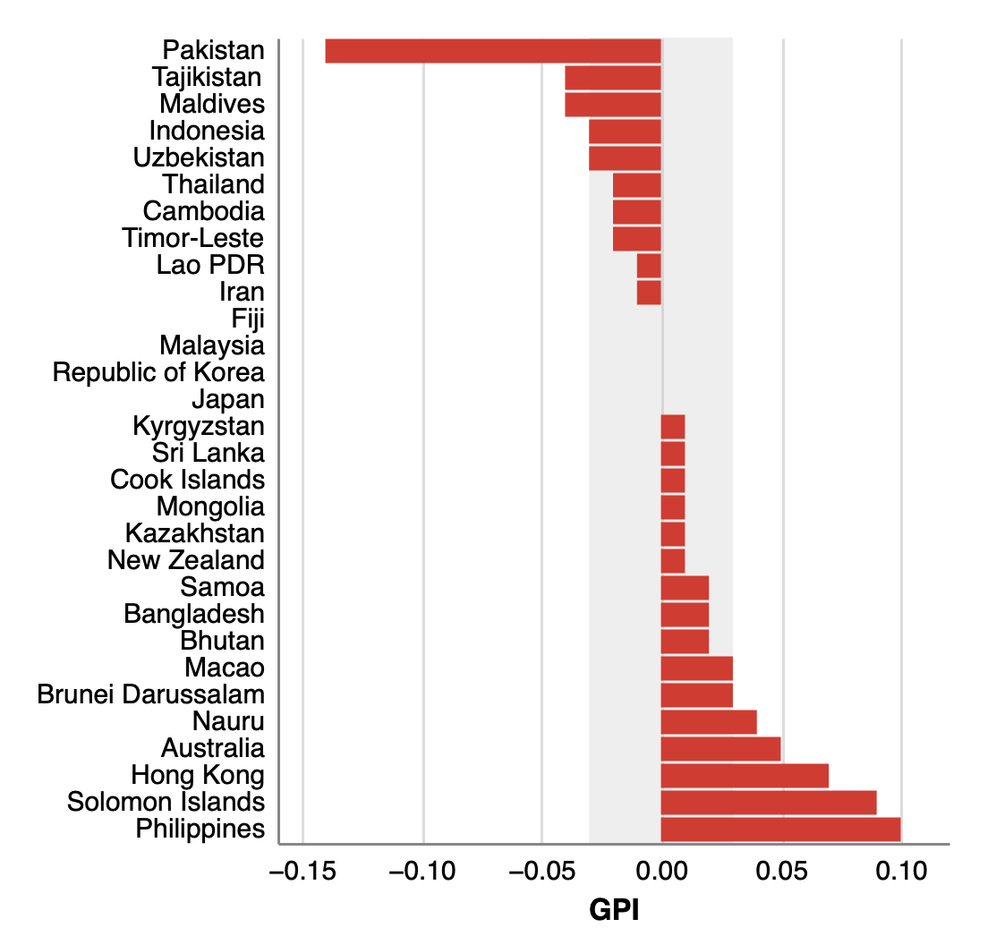
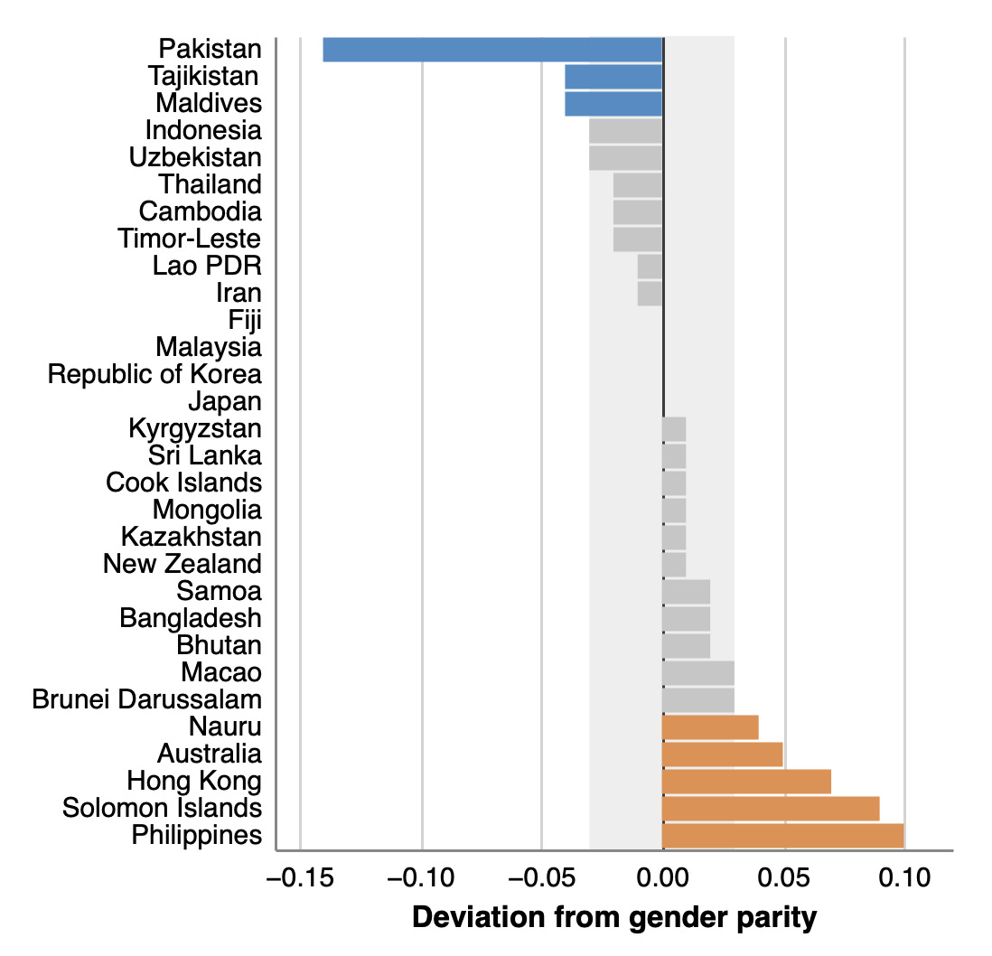
Example 6. In Vega-Lite.
Using conditionals in your charts
With a condition property, we can define rules for encodings. For example, we can highlight points or rows by value.
"color": {
"condition": [
{
"test": "datum.diff < -0.035",
"value": "rgb(69,141,198)"
},
{
"test": "datum.diff > -0.035 && datum.diff <= 0.035",
"value": "rgb(198,198,198)"
},
{
"test": "datum.diff > 0.035",
"value": "rgb(230,142,72)}]

Slide 50
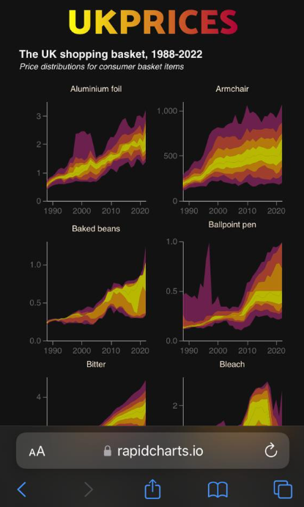
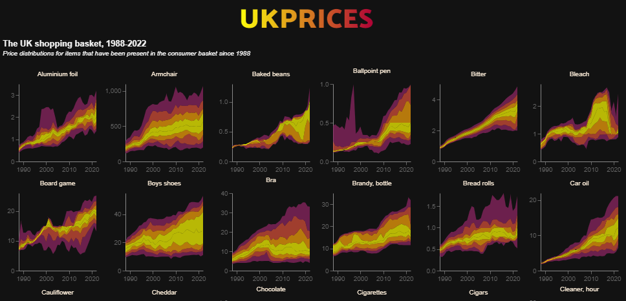
Example 7: screen sizes
Excel | STATA | Python | JavaScript | CSS
https://rapidcharts.io/prices
Phone
Desktop

Slide 51
Example 7: screen sizes
Excel | STATA | Python | JavaScript | CSS
<!-- CONDITIONAL SCRIPT TO EMBED BASED ON SCREEN WIDTH -->
<script>
// Find the current screen width:
let width = screen.width;
// Use an if function to pick the approprite visualisation:
if (width > 950) {
prices1 = "charts/ONSinflation/distributionsPerrenials_DarkWide.json";
} else if (width > 450) {
prices1 = "charts/ONSinflation/distributionsPerrenials_DarkMedium.json";
} else {
prices1 = "charts/ONSinflation/distributionsPerrenials_DarkNarrow.json";
}
// Now embed the chart, which will vary based on screen width:
vegaEmbed('#chart1', prices1, {"actions": false});
</script>

Slide 52
Example 8 – in CSS.
Excel | STATA | Python | JavaScript | CSS
/* Some CSS to alter the colour of my site */
body{
background-color: white;
}
/* Screen size 1 */
@media screen and (max-width: 450px) {
body {
background-color: lightblue;
}
}
/* Screen size 2 */
@media screen and (max-width: 600px) {
body {
background-color: blue;
}
}
/* Screen size 3 */
@media screen and (max-width: 800px) {
body {
background-color: pink;
}
}
What colour on:
Smartphone?
Laptop?
iPad?

Slide 53
5.2 Loops. Doing a task again and again, and again and again, and …

Slide 54
Code as a tree | Conditional statements influence which branch your code goes along.
Now your code is working nicely, for one country, or one company, or one year.

Slide 55
But you want to look at all the countries, all the companies, all the years.

Slide 56
Example 8 – in CSS.
Excel | STATA | Python | JavaScript | CSS
/* Some CSS to alter the colour of my site */
body{
background-color: white;
}
/* Screen size 1 */
@media screen and (max-width: 450px) {
body {
background-color: lightblue;
}
}
/* Screen size 2 */
@media screen and (max-width: 600px) {
body {
background-color: blue;
}
}
/* Screen size 3 */
@media screen and (max-width: 800px) {
body {
background-color: pink;
}
}
What colour on:
Smartphone?
Laptop?
iPad?
Notes:
Not sure if this slide is meant to be repeated here?

Slide 58
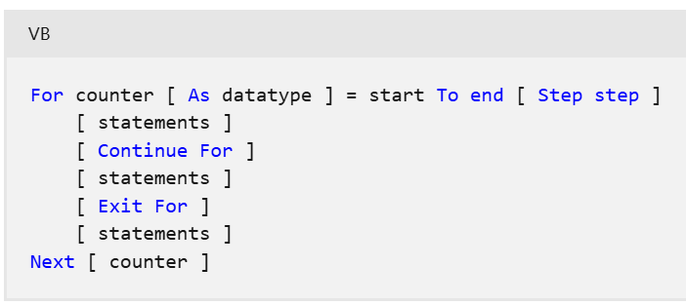
Loops.
Excel | STATA | Python | JavaScript | CSS
The Excel GUI is not built for iteration.
You can write loops in its background language VBA
If you must do this, the code snippet you are looking for is called “For-Next”. It is not like loops in Python, JS or Stata though.

Slide 59
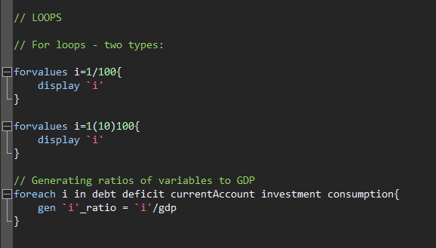
Loops.
Excel | STATA | Python | JavaScript | CSS

Slide 60
Loops.
Excel | STATA | Python | JavaScript | CSS
for i in range (1, 100):
print i
for i in range (1, 10, 100):
print i
for i in range (1, 100, 10):
print i
variables = ["debt", "deficit", "GDP", "inflation"]
for i in variables:
print(i)
An example of subtle differences between languages / functions.

Slide 61
Loops.
Excel | STATA | Python | JavaScript | CSS
for (statement_1; statement_2; statement_3) {
// Code block to run
}
What happens here:
Statement_1 runs once, before the code block starts.
Statament_2 defines a condition that must hold for the code block to run.
Statement_3 runs each time the code block has been executed.

Slide 62
Loops.
Excel | STATA | Python | JavaScript | CSS
for (let i = 1; i < 101; i++) {
console.log(i);
}
for (let i = 1; i < 101; i+10) {
console.log(i);
}

Slide 63
Loops.
Excel | STATA | Python | JavaScript | CSS
// Set a list of variables:
variables = ["debt", "deficit", "GDP", "inflation"]
// We can index these:
console.log(variables)
console.log(variables[0])
console.log(variables[3])
// Work out how long this thing is:
len = variables.length
// Iterate though it, printing out each particular variable
for (let i=0; i<len; i++) {
x = variables[i]
console.log(x)
}
Example in this week’s DropBox folder

Slide 64
Loops.
Excel | STATA | Python | JavaScript | CSS
Again CSS is not really built for looping
However, it can repeat commands. An example: @keyframes (an At-Rule).
One example is the @keyframes
@keyframes border-pulsate2 {
0% { border-color: #22e68b}
10% { border-color: rgba(230, 34, 75, 0)}
20% { border-color: rgba(230, 34, 75)}
30% { border-color: rgba(230, 34, 75, 0)}
40% { border-color: rgba(0, 47, 167)}
50% { border-color: rgba(230, 34, 75, 0)}
60% { border-color: rgba(250, 250, 0)}
70% { border-color: rgba(230, 34, 75, 0)}
80% { border-color: #22e68b}
}
.readingWeek {
background-color: #122b39;
border-radius: 10px;
border-style: dotted;
border-width: 5px;
height:100%;
animation: border-pulsate2 2s infinite;
}

Slide 65

Loops.
Excel | STATA | Python | JavaScript | CSS
Again CSS is not built for looping
However, it can iterate over certain commands for a given time. One example
@keyframes border-pulsate2 {
0% { border-color: #22e68b}
10% { border-color: rgba(230, 34, 75, 0)}
20% { border-color: rgba(230, 34, 75)}
30% { border-color: rgba(230, 34, 75, 0)}
40% { border-color: rgba(0, 47, 167)}
50% { border-color: rgba(230, 34, 75, 0)}
60% { border-color: rgba(250, 250, 0)}
70% { border-color: rgba(230, 34, 75, 0)}
80% { border-color: #22e68b}
}
.readingWeek {
background-color: #122b39;
border-radius: 10px;
border-style: dotted;
border-width: 5px;
height:100%;
animation: border-pulsate2 2s infinite;
}

Slide 66
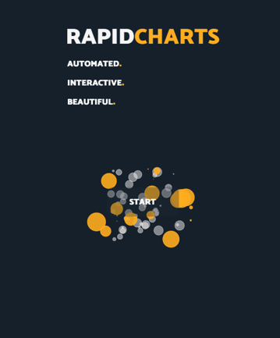
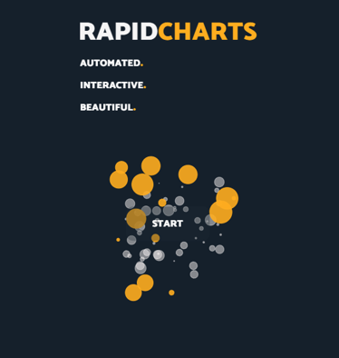
Using loops.
Exploding bubbles
https://rdeconomist.github.io/index_old
Code intuition:
For n bubbles, pick a size, x direction and y direction. Use random numbers so different each time.
Notes:
RS: insert example of a terrible chart

Slide 67
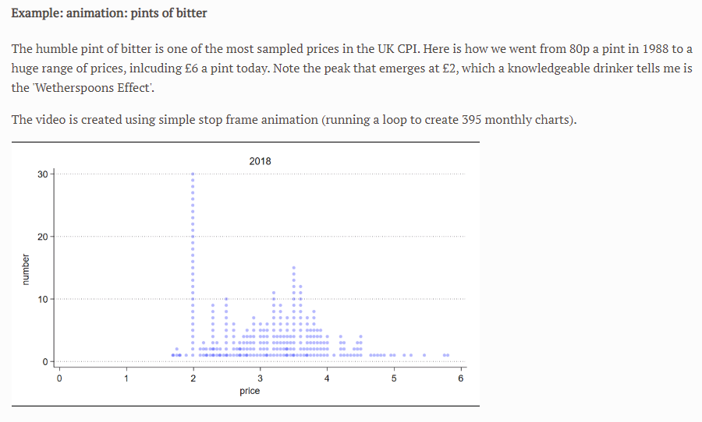
Using loops.
Stop frame animation
Watch the video here:
https://richarddavies.io/research/prices
Code intuition:
For dates i, draw histogram if date==i. Save chart as png.
Notes:
RS: insert example of a terrible chart

Slide 68
Using loops.
Batching analysis
Problem: We often have too much data
How can visualising help us understand the data in the early stage of a project?
Code intuition:
Think of a chart that summarises the data in some useful way:
[Useful options: histogram, percentiles as a swathe.]
Code this chart for one part (one firm, one year, one product).
Use a loop: for each product, draw the chart
Example: UK CPI data, which has ~1300 products.
Notes:
RS: insert example of a terrible chart

Slide 69
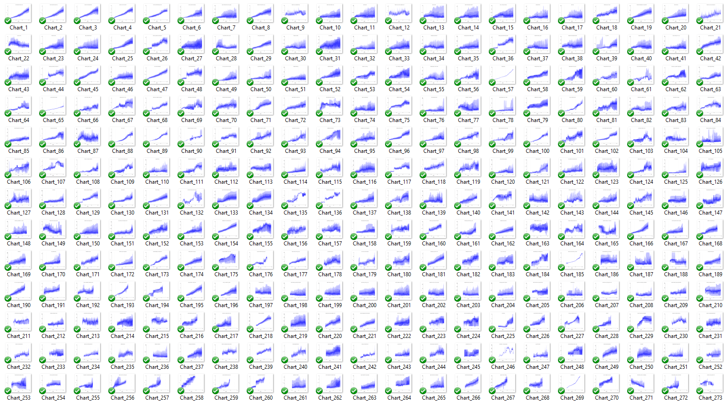
Notes:
RS: insert example of a terrible chart

Slide 70
Break. Then: portfolios, projects, practical.

Slide 71
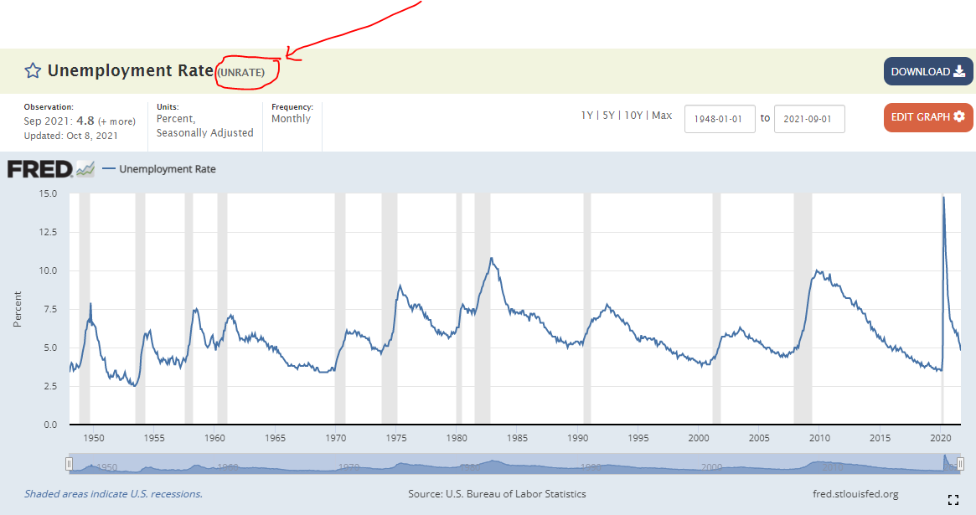
Break. Find two series on FRED that you are interested in. Make a note of their codes: https://fred.stlouisfed.org/

Slide 72
Resources. Add your site to the google sheet.
Resource 1: my site:
www.richarddavies.io/data-science
Resource 2: chart library.
www.richarddavies.io/library
Resource 3: course Google sheet.
Google sheet. Link.
Resource 4: course DropBox.
DropBox. Link.
Google
Sheet
DropBox

Slide 73
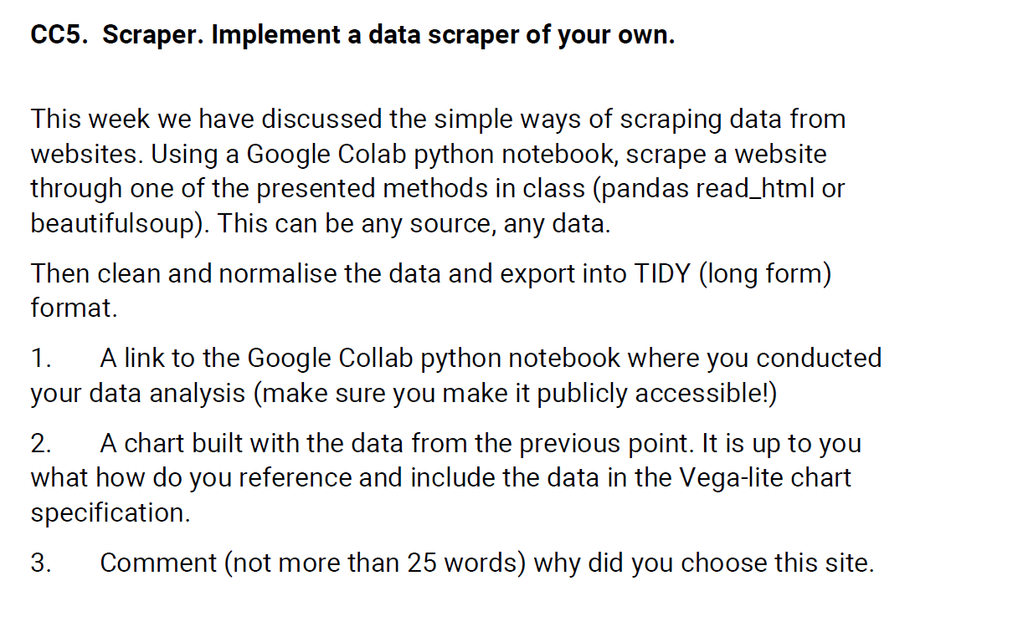
Portfolio. This week’s task

Slide 74
Projects. Let us know what you are working on!
Google
Sheet

Slide 75
5.3 Building dashboards. Using loops to analyse multiple data series Looping over a list of countries to create create dynamic API-linked charts.

